Slide 1
Front-End Web Development Using React (HTML5)
Front-End Web Development Using React – HTML5
Eng. Reem Hassan Ahmed

Slide 2
Table of contents
01
04
02
05
03
06
Semantic elements
Geolocation API
Drag/Drop API
07
Media
Local storage
Form enhancements
Canvas API

Slide 3
01
Semantic elements
Front-End Web Development Using React – HTML5

Slide 4
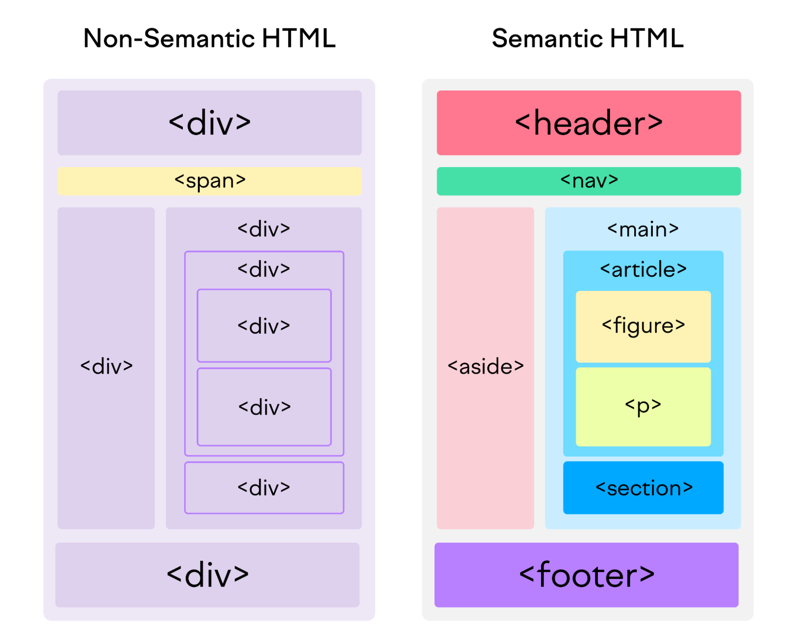
Semantic elements
It is the use of HTML tags that accurately reflect the content they contain.
The <header> element represents a container for introductory content or a set of navigational links.
The <section> element defines a section in a document.
The <article> element specifies independent, self-contained content.
The <aside> element defines some content aside from the content it is placed in (like a sidebar).
The <nav> element defines a set of navigation links.
All semantic elements are block-level elements.

Slide 5
02
media
Front-End Web Development Using React – HTML5

Slide 6
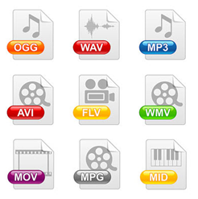
Media (Audio and Video)
Media are supported in HTML5 using <audio> and <video> tags.
The HTML <video> element is used to show a video on a web page.
To play an audio file in HTML, use the <audio> element.

Slide 7
APIs in HTML5 API stands for Application Programming Interface. An API is a set of pre-built programs that can be used with the help of JavaScript. APIs are used to implement already written code to fulfill the needs of the project you are working on.

Slide 8
03
Drag/Drop
Front-End Web Development Using React – HTML5

Slide 9
Drag and Drop
Drag/Drop API allows you to grab any element in the DOM and drop it to a different location.
To create an element able to drag and drop, set the attribute “draggable” on the tag and put its value to true.

Slide 10
04
Geolocation API
Front-End Web Development Using React – HTML5

Slide 11

Geolocation
The Geolocation API is an HTML feature that is used to access the geographical position of a user, however, it is not accessed unless the user approves of it
The getCurrentPosition() method is used to return the user's position.

Slide 12
05
Canvas
Front-End Web Development Using React – HTML5

Slide 13
Canvas API
The Canvas API allows JavaScript to draw graphics on the canvas.
The Canvas API can draw shapes, lines, curves, boxes, text, and images, with colors, rotations, transparencies, and other pixel manipulations.
The <canvas> element is only a container for graphics. You must use JavaScript to actually draw the graphics.

Slide 14
06
Form enhancements
Front-End Web Development Using React – HTML5

Slide 15
Form enhancements
New input types (email, date, time, url, number, etc.), new attributes (placeholder, autofocus, required, etc.).
New form elements (<datalist>, <output>, <progress>, <meter>).
The <input type="email"> is used for input fields that should contain an e-mail address.
The e-mail address is automatically validated when submitted.
The <input type="url"> is used for input fields that should contain a URL address.
The url field is automatically validated when submitted
The <input type="date"> is used for input fields that should contain a date.
A date picker can show up in the input field.
The <input type="time"> allows the user to select a time (no time zone).
A time picker can show up in the input field.
The <input type="number"> defines a numeric input field. (You can set restrictions on what numbers are accepted).
The input autofocus attribute specifies that an input field should automatically get focus when the page loads.

Slide 16
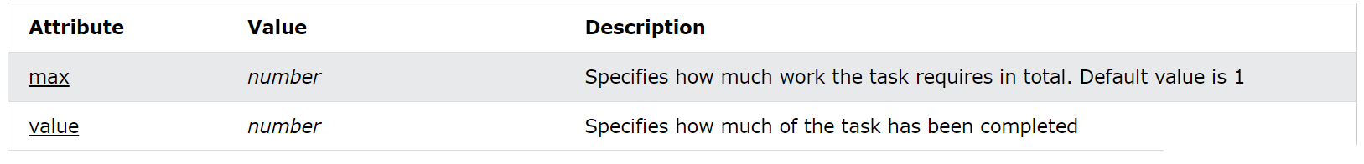
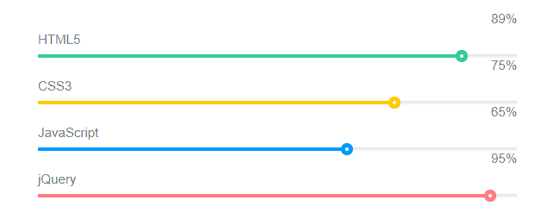
Progress bar
The <progress> tag represents the completion progress of a task.

Slide 17
07
Local storage
Front-End Web Development Using React – HTML5

Slide 18
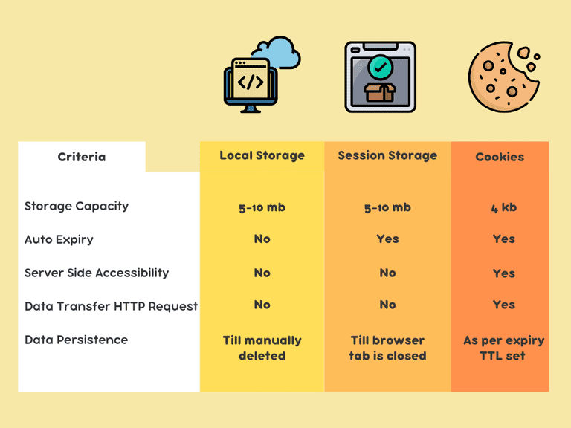
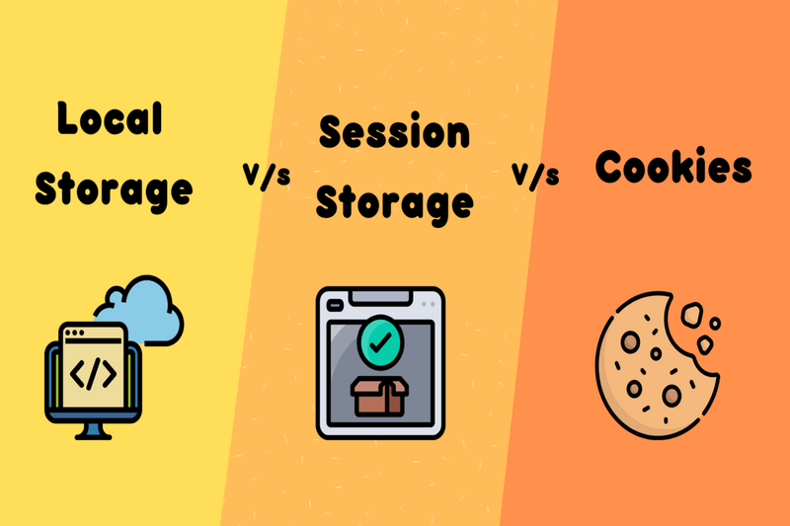
Local storage
The localStorage object allows you to save key/value pairs in the browser with no expiration date.

Slide 19
Thanks!
Front-End Web Development Using React – HTML5
Does anyone have any question?
ReemHassan160299@gmail.com
+201092427577
Please keep this slide for attribution

